Slide 1
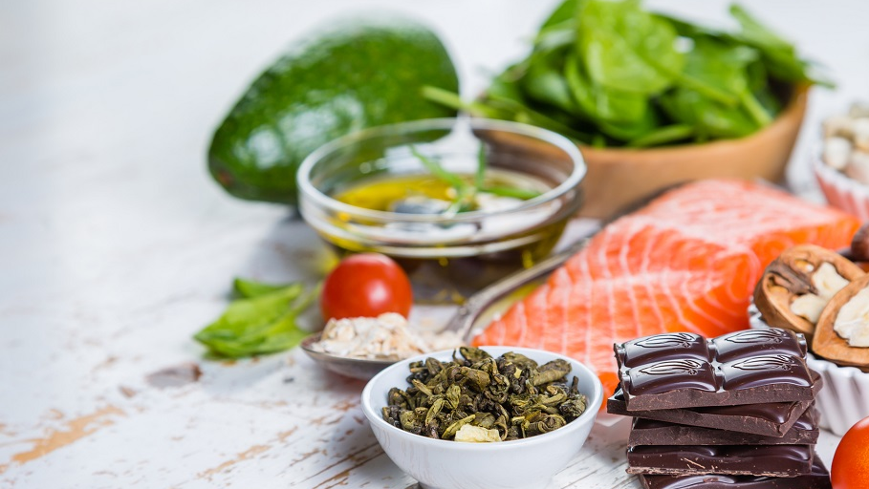
Salad Mixer!
Salad Made Easy
& Delicious !
Join US
11:30am – 1:30pm Saturday 20th January
3207 West Gate Lane, Richardson TX 75092
Please RSVP Bring 4 Mason Jars Bring 2 to 3 Salad!

Slide 2
Salad Mixer!
Start Your New Year with Good Habits!
Customize Your Own Salad
Healthy Dressing
Kick Start Your Detox
Repair Your Digestive System
Make Eating Healthy Fun
Salad Made Easy
& Delicious !
11:30am – 1:30pm Saturday 20th January
3207 West Gate Lane, Richardson TX 75092
Please RSVP:
Roseanna @ 817 688 8229 Bring 4 Mason Jars Bring 2 to 3 Salad!

Slide 3
S
S
ip
&
hop
Its Time to have Fun Spending !
Sample Products
Learn how Spending can be an Asset!
We Invite you To Join US
Thursday 18 Jan at 7pm
Its Time to have Fun and Save Money
2548 Rue De Ville
Irving Tx 75038

Slide 4
S
S
S
ave
ip
Its Time to have Fun Spending!
Sample Products
Learn How Spending Can Be An Asset!
We Invite you To Join US
Thursday 25th Jan at 7pm
Its Time to have Fun and Save Money
1033 Colleton Ln Frisco, TX 75033
hop
&

